Slide 1

Customer Insights and Segmentations

Slide 2
Customer Segmentation Using Profit Distribution
OBJECTIVE Identify and focus on customers contributing significantly to our profit distribution.
ANALYTICAL APPROACH By examining the distribution of customer profit contributions, a smaller segment of customers (6%) contributes a disproportionately large percentage of our profit (approx. 50%). UPDATES
As profit distributions shift, our segment criteria will adapt to capture the most valuable customers.
CAVEAT
The approach prioritizes profit maximization, there are other customer behaviors or attributes we might explore in future segmentation iterations.

Slide 3


Data Sources
Timeline
Limitation
Sales Data
Online Visits
The preliminary segments might not be fully representative of the entire customer base.
Jan 2020- June 2023
Small sample sizes within segments could lead to unreliable insights and conclusions.

Slide 4
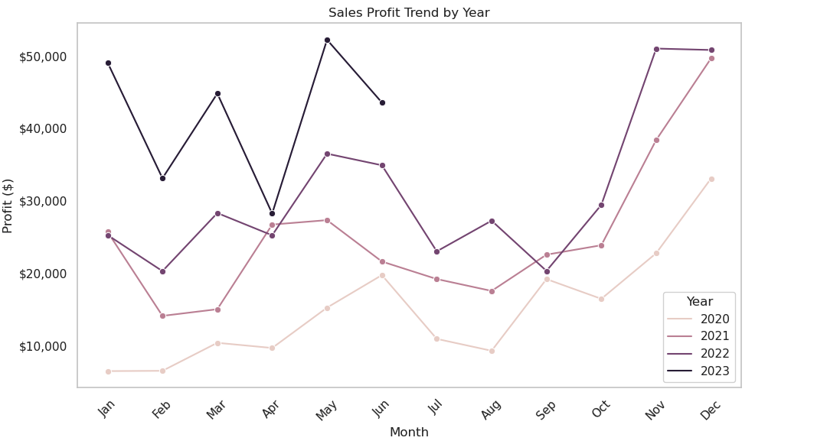
86% Increase in sales profit during Q4

Slide 5
30%
38%
61%
1%
69%
1%
Platforms and Devices Visits

Slide 6
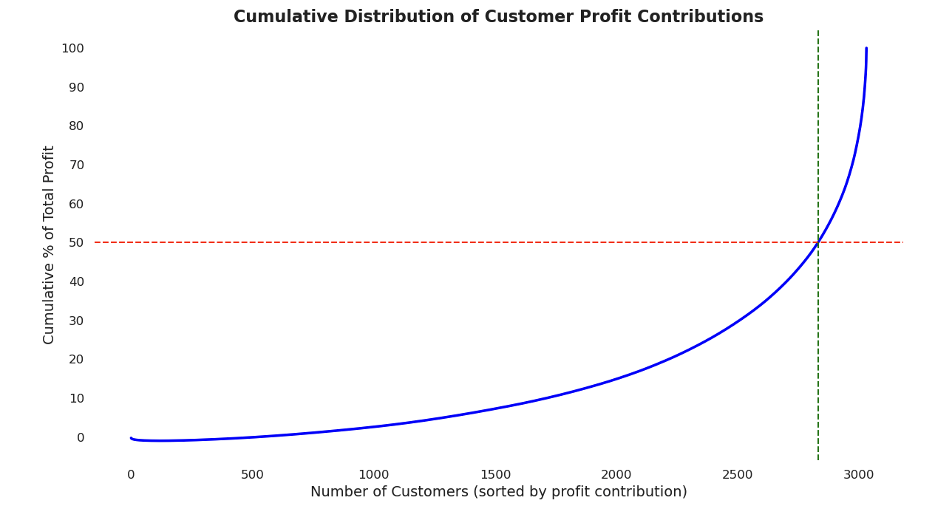
High-Value Customers

Slide 7

High-Value Customers
6%
Total Customers
50%
Total Profit
14x
Higher Average Profit per Ticket
8x
Higher Average Buying Frequency

Slide 8
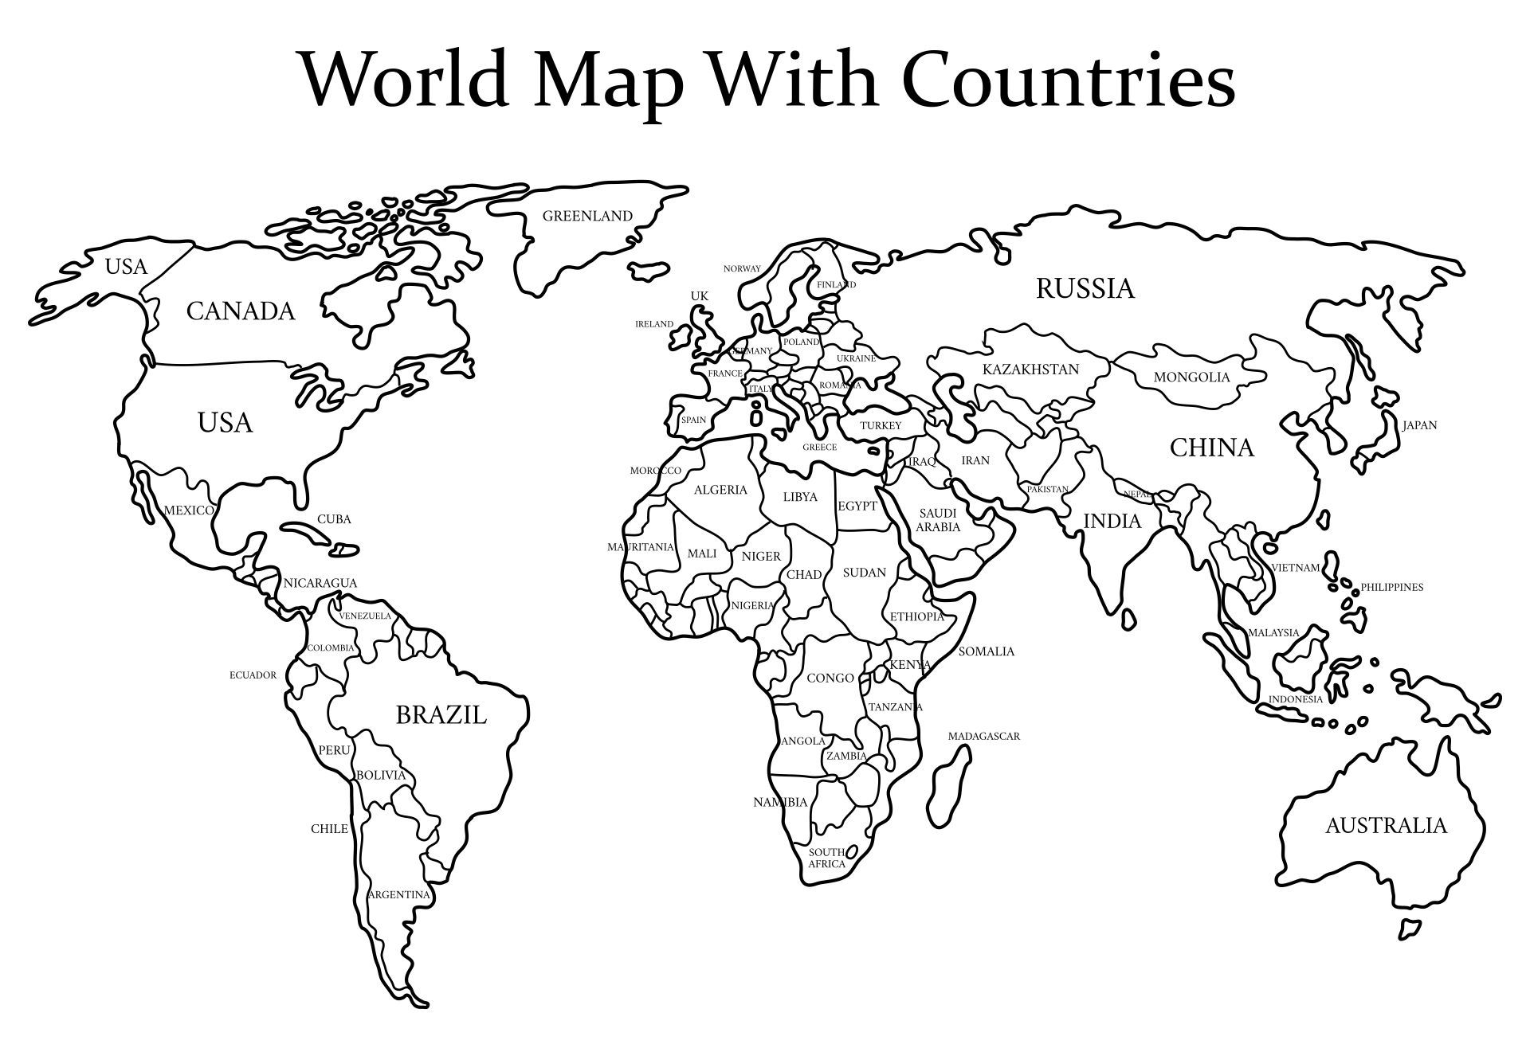

89% of high-value customers are concentrated in the following countries
United States, Canada, and China.

Slide 9

Recommendations
High-value customers are 14 times more profitable.
Prioritize those customers in marketing campaigns and early access to new products
Direct our marketing resources towards the identified high-value regions.
A substantial portion of our customer base uses mobile devices to access our services.
Prioritize mobile-friendly marketing content and ensure seamless user experience for mobile web users.
86% Increase in sales profit during Q4
Opportunity to leverage Q4 momentum in launching new products during the high seasons.

Slide 10

Next Steps
Score the health of high-value customers.
Deep dive analysis on features usage on our platform for improving and personalizing customer experience.

